Slide 1
The battle of neighbourhoods-New York Restaurants

Slide 2
introduction
New York city review in order to analyse the opportunity to open a new Italian restaurant business
Business problem consists in:
-choice of first neighbourhood to start an Italian restaurant business
-easy to replicate a restaurant
-low competition in the neighbourhood area
-high demand
-choice of menu

Slide 3
New York city-short presentation
Most numerous population in United States
Financial capital of United States
Multicultural town
Providing a lot of business opportunities
Business friendly environment
Global hub for business and commerce

Slide 4
Problem statement
Select the best neighbourhood to live, build a restaurant in New York
Understanding the similarities and differences between the neighbourhoods using Unsupervised K-means clustering algorithm; K-means clustering is a type of unsupervised machine learning, the goal of the algorithm is to find unlabelled groups in the data; data points are clustered based on feature similarity

Slide 5
objective
Collecting Neighborhood’s top trending venues using Foursquare API (Beautiful Soup, http request)
Forming neighbourhood clusters based on venue categories using unsupervised k-mean algorithm (sklearn)
Identifying and understanding the similarities and differences between two chosen neighbourhoods to retrieve more insights regarding opportunity to conclude which area wins over others to set up an Italian business restaurant

Slide 6
Data description-neighborhoods
Data 1:Neighborhood has a total of 5 boroughs and 306 neighbourhoods
This dataset is already available on the web, the link is:
https://geo.nyu.edu/catalog/nyu_2451_34572

Slide 7
Data description-farmers’ markets
The data is available at the following link: https://data.cityofnewyork.us/dataset/DOHMH-Farmers-Markets-and-Food-Boxes/8vwk-6iz2

Slide 8
Data description-demographics & cuisine
Data from Wikipedia pages as given below :
https://en.wikipedia.org/wiki/New_York_City
https://en.wikipedia.org/wiki/Economy_of_New_York_City
https://en.wikipedia.org/wiki/Portal:New_York_City
https://en.wikipedia.org/wiki/Cuisine_of_New_York_City

Slide 9
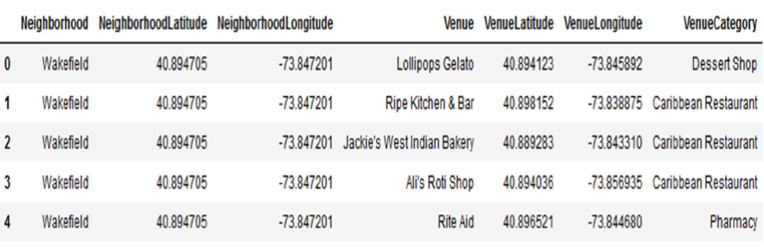
Data description-venues
Data was taken from foursquare.com
Newyork city geographical coordinates data will be utilized as input for the
Foursquare API, that will be leveraged to provision venues information for each
neighborhood. We will use the Foursquare API to explore neighborhoods in New
York City

Slide 10
Python packages and dependencies
Pandas-library for data analysis
Numpy-library for handle data in a vectorised manner
JSON-library to handle JSON files
Geopy-to retrieve location data
Requests-library to handle HTML requests
Matplotlib-Python plotting module
Sklearn-Python machine learning library
Folium-map rendering library

Slide 11
Work flow
Web scraping and data wrangling
Top trending places extraction and clustering
Decision making based on clustered neighbourhoods, population distribution, competition(other cuisine types opened in the same area),access to Farmers markets which are suppliers for the business
New York city neighborhood has a total of 5 boroughs and 306 neighborhoods
• PART 1 - Clustering of Manhattan and Brooklyn
• PART 2 - Clustering of Bronx, Queens and Staten Island.
• Only restaurant data is filtered from foursquare.com venues data and was further utilized for this project.
This is performed through the following Exploratory data analysis

Slide 12
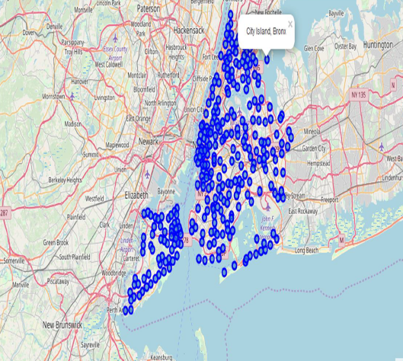
Methodology-1
Data 1-New York city Geographical coordinates Data
Load the data and explore-newyosk_data.json
Transform the data of nested python dictionaries into a panda dataframe
Dataframe contains the geographical coordinates of NYC neighborhoods
Data will use to get Venues data from Foursquare
Geopy and folium libraries were used to create a map of New York

Slide 13
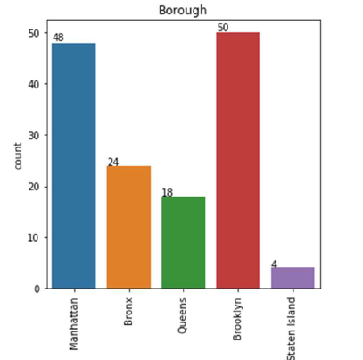
Methodology-2
Data 2-DOHMH Farmers Markets and Food Boxes dataset
There are totally 144 Farmers Markets in New York city
Highest number are in Manhattan and Brooklyn
Lowest are in Queens & State Island

Slide 14
Methodology-3
Data 3:To analyse New York population, demographic data regarding cuisine scrapped the data from Wikipedia pages given above in the data section.
BeautifulSoup Python library was used

Slide 15
Methodology-3 New York population
Manhattan (New York County) has the geographically smallest area and the population with highest density.
Brooklyn is the city’s most populated borough
Queens, on Long Island north and east of Brooklyn, is geographically the largest borough.

Slide 16
METHODOLOGY 3-New York city demographics
New York is the most populated city in US, with an estimated record high of 8.7 mio residents as of 2017, incorporating more immigration into the city than outmigration➔ cuisine is different and various
Being a mixture of racial composition ,NYC has restaurants serving cuisine from many cultures and countries: Italian, Indian, African etc.

Slide 17
Methodology 3-cuisine of nyc
This data has been manually prepared. Data is taken from Wikipedia page
Data was used to create word cloud
Most preferred food in NYC_ Italian, Mexican,Puerto Rican, Jewish, Indian

Slide 18
Methodology 3-cuisine of NYc
Brooklyn cuisine
Manhattan cuisine

Slide 19
Methodology 4-using foursquare.com
New York city geographical coordinates data has be utilized as input for the Foursquare API, that has been leveraged to provision venues information for each neighborhood.
We used the Foursquare API data to explore neighborhoods in
New York City.
Using the geographical coordinates of each neighborhood foursquare API calls are made to get top 200 venues in a radius of 1000 meters
PART – 1 Brooklyn and Manhattan
PART – 2 Bronx, Queens and Staten Island

Slide 20
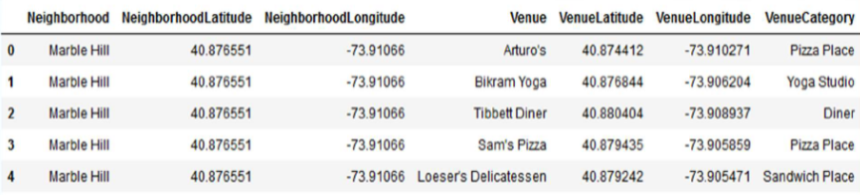
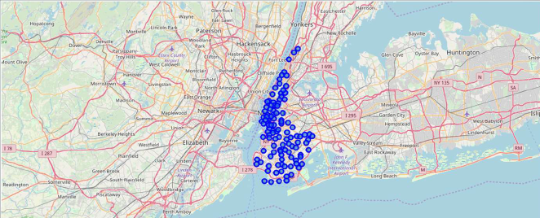
Methodology 4-using foursquare.com
Venues data
Visualization

Slide 21
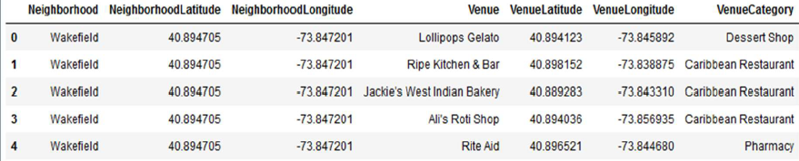
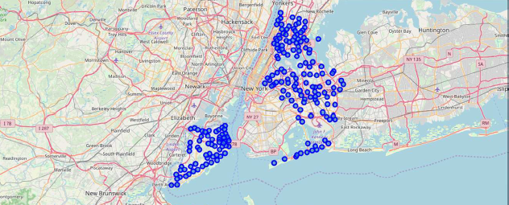
Methodology 4-using foursquare.com
Bronx, Queens and Staten Island Venues data
Visualization

Slide 22
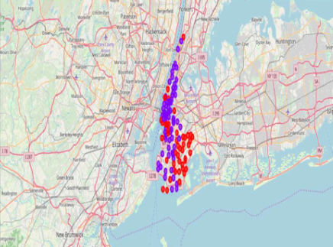
Results Brooklyn & Manhattan
Segmenting and clustering neighbourhoods
Cluster0:sum of cluster0 has smallest value➔ the market is not saturated
Cluster1:Total sum is very high➔ lot of competition meaning saturated neighbourhoods; cluster 1 is basically the residential area, each neighbourhood has access to fast food and restaurants and outdoor facilities. there are also a lot of restaurants, convenience stores and supermarkets

Slide 23
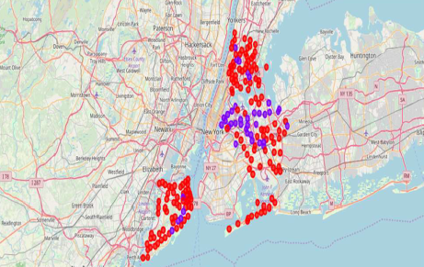
Results Bronx, queens and staten island
Cluster0: Sum of cluster0 has smallest value➔ market is not saturated
Cluster1: Sum is very high. Lot of competition➔Saturated neighborhoods

Slide 24
discussion
Scope was to explore cuisines of various countries in Bronx, Queens & Staten Island
In Manhattan and Brooklyn restaurants, cuisines from many countries can be found in their menu➔ there is a strong demand to explore cuisines from various countries
Regarding the suppliers there is room to increase Farmers markets in Bronx, Queens, and Staten Island

Slide 25
conclusion
The above mentioned analysis is performed on the limited data
More data could be considered from detailed sources, also some other variables (e.g. the consumer behaviour, people average income) might be taken into account
Brooklyn and Manhattan has high concentration of restaurant business and the market is very competitive
The other analysed areas(Queens, Bronx, Staten Island) also has good number of restaurants but not as many as required, here is an opportunity might be explored for opening a new Italian restaurant

Slide 26
Thank you!

